Slide 1
Confidentiality Coalition Meeting
September 16, 2021

Slide 2
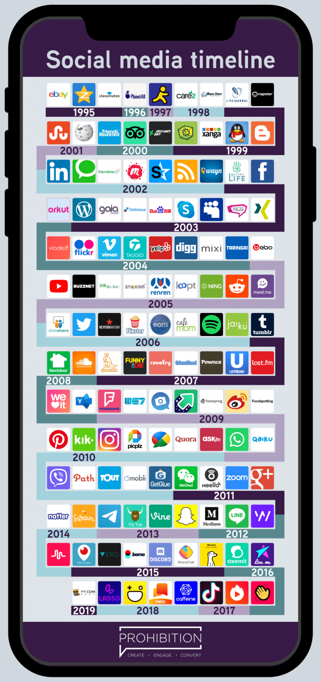
Significant Changes in Reality

Slide 3
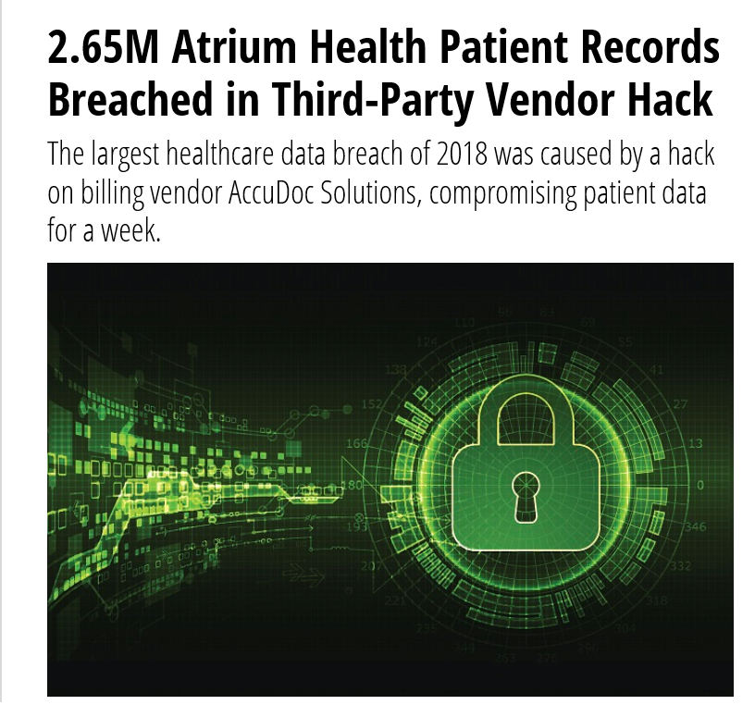
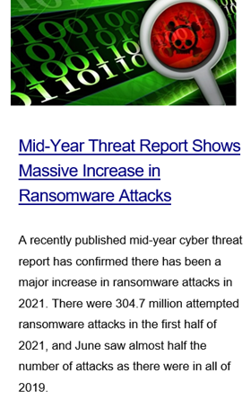
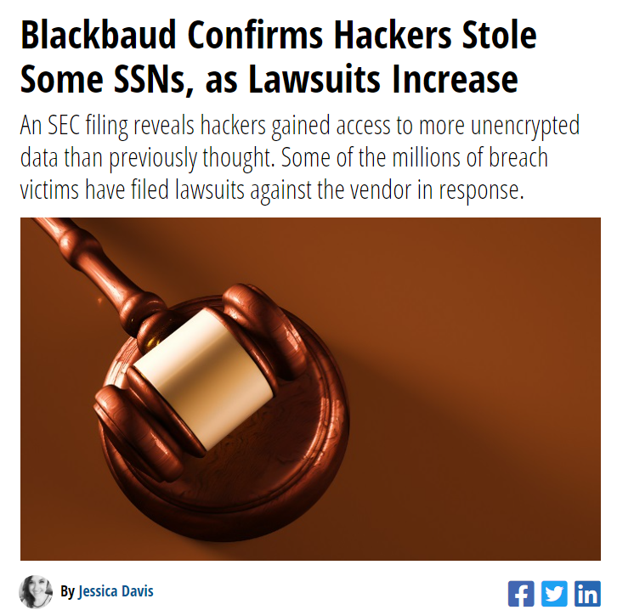
Landscape of Breaches
HealthITSecurity.com and HIPAA Journal

Slide 4
Breach Fatigue and Confusion

Slide 5
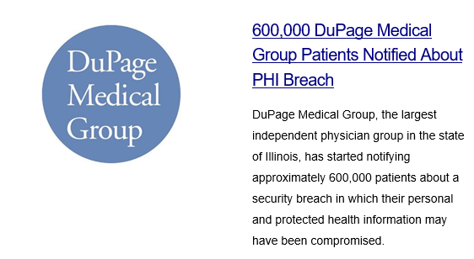
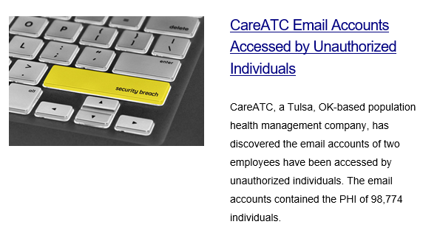
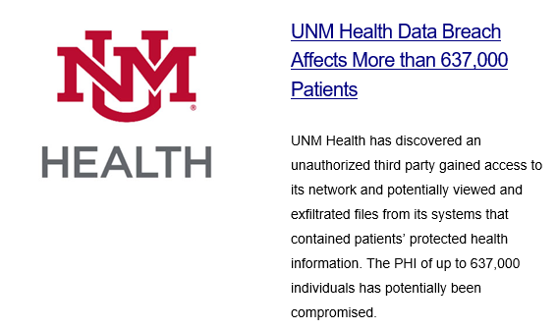
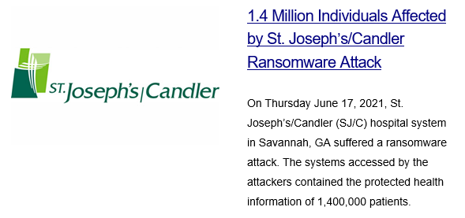
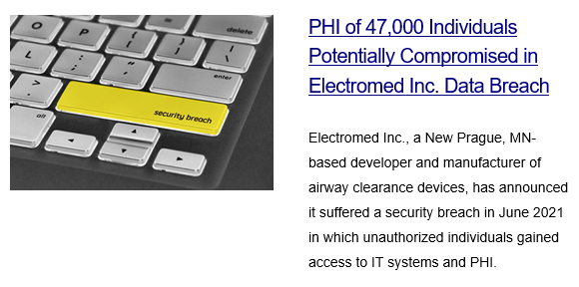
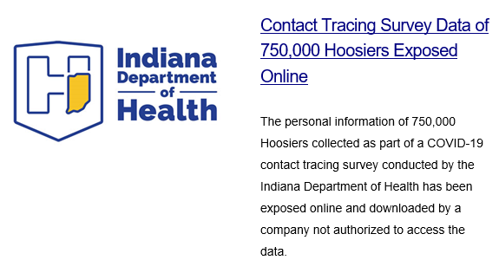
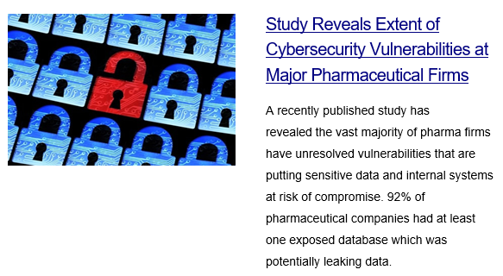
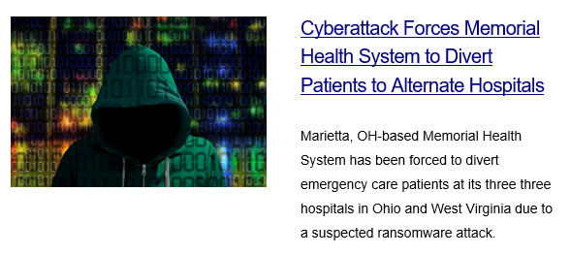
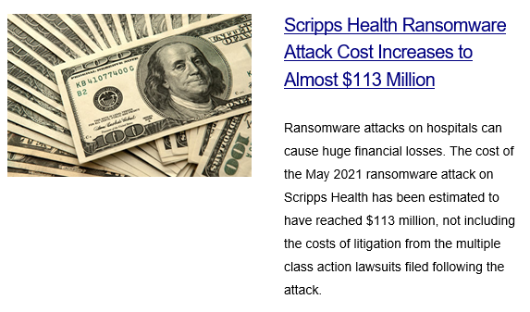
From 8/23/21 and 9/7/21 Journals

Slide 6
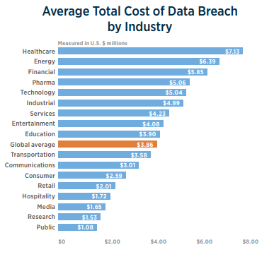
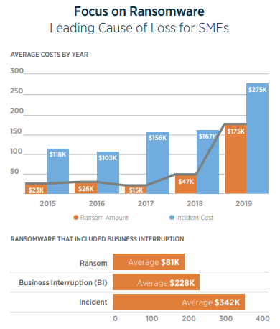
Hardening Insurance Market
From Gallagher’s Market Conditions February 2021 Report

Slide 7
Tension of Information Sharing and Privacy/Security
Patient
OCR
CMS

Slide 8
A Discussion About the Road Ahead for Privacy and Security
What changes are needed so privacy laws are effective and realistic?
How can we reasonably protect patient information and still support open exchanges of information?
How do we have enough resources to care for patients in the face of lawsuits, breach notification costs, and reputational harm?

Slide 9
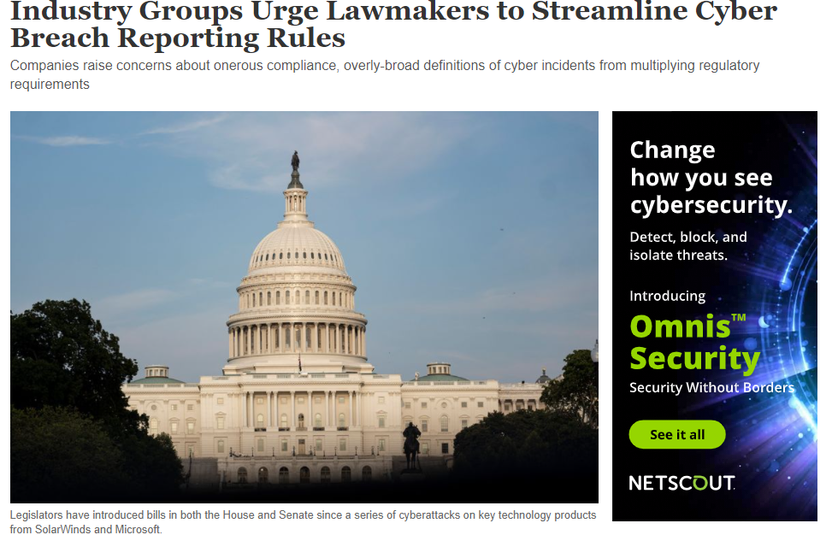
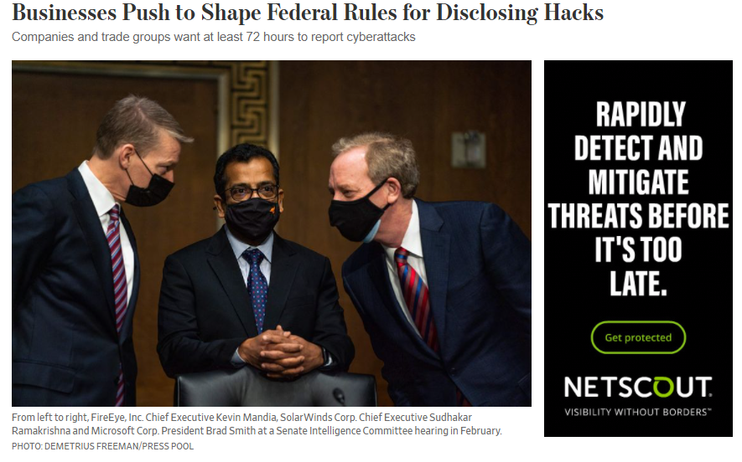
Current Activity
Industry Groups Urge Lawmakers to Streamline Cyber Breach Reporting Rules – WSJ
Businesses Push to Shape Federal Rules for Disclosing Hacks (wsj.com)

Slide 10
State of the Privacy Laws
https://uschamber.com/data-privacy

Slide 11
HIPAA: Still the Same at Its Core
2003
HIPAA Privacy Rule enforced with PHI defined
2005
HIPAA Security Rule enforced
2009
HITECH Act with significant risk of harm Breach Rule and BA limited liability
2013
Final Rule with changes to low risk of compromise Breach Rule
2020
HHS issues NPRM focusing on access and care coordination
2021
(Information Blocking Rule)

Slide 12
Some Thoughts for Discussion
Updating definition of PHI to be more reflective of what is truly “confidential information” in an electronic age
Returning to a “significant risk of harm” standard for breaches so as to make notifications meaningful and effective
Removing media notification and Wall of Shame publication from the Breach Notification Rule to support consistent and accurate breach notification
Securing guidance on what to do with commingled information in the world of EHR extension and integrated records

